Slide 1
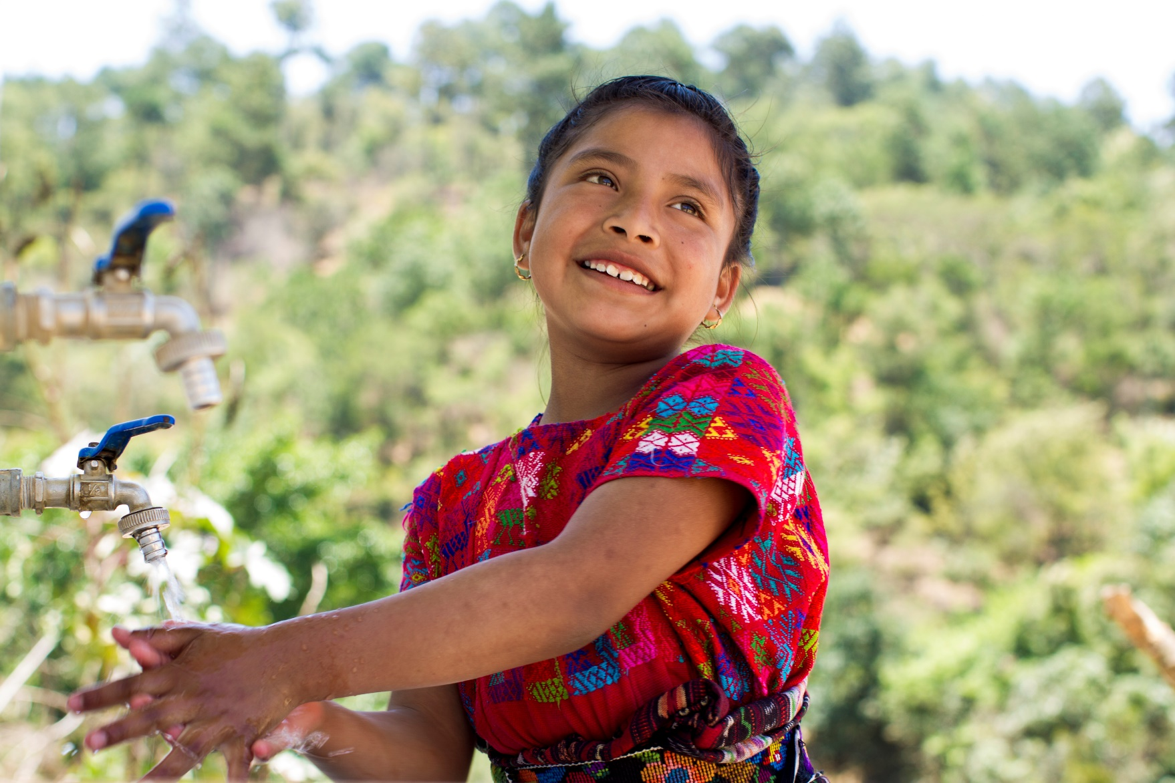
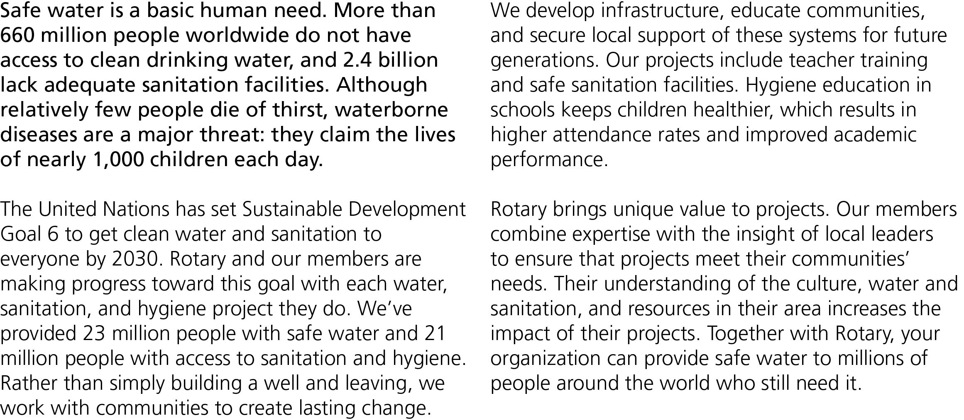

Slide 2
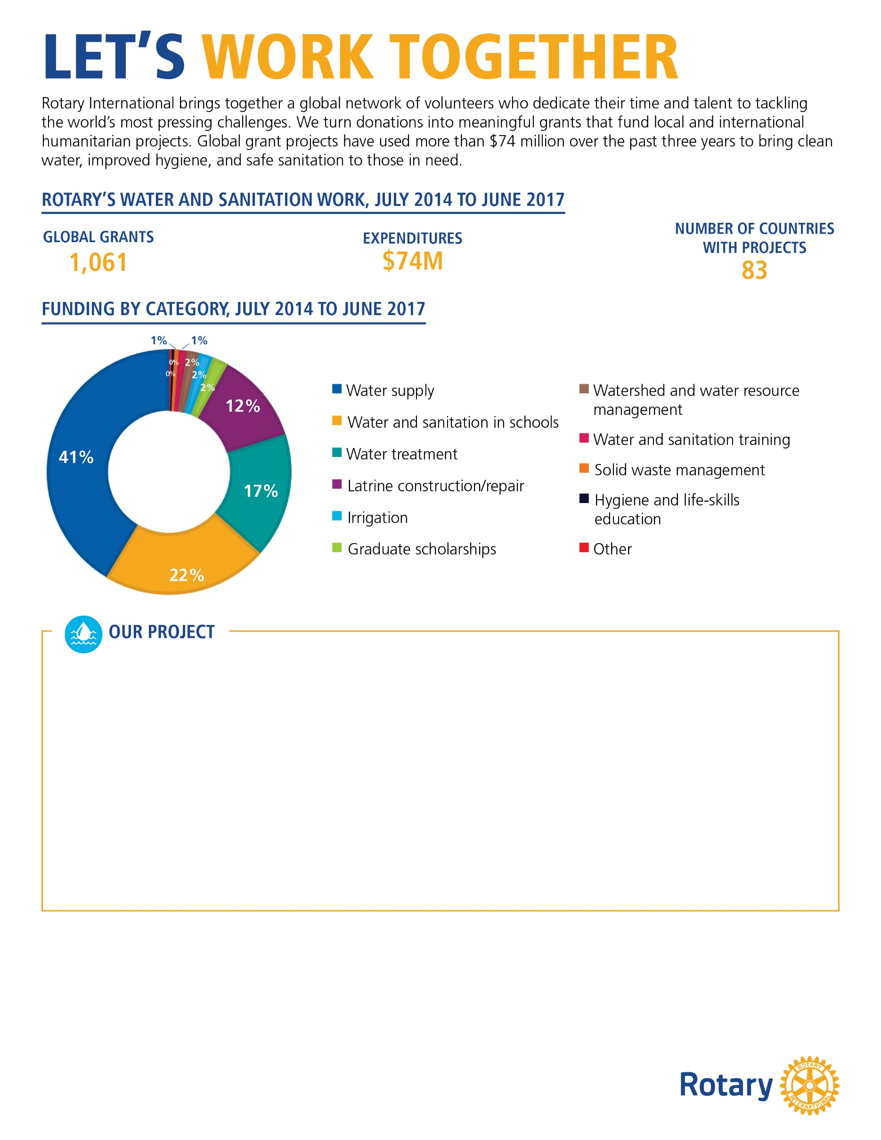
[In 500 words or less, describe a water and sanitation project that your club or district either worked on or is currently working on. Please use 12-point Georgia font. It’s also a good idea to include photographs of your project.
Your description should include:
The problem your project addresses and how it was discovered
A brief description of your community and how the project benefits it
How the partner organization’s involvement improves the project and its outcome
If the project is complete, its impact on the community (example: provided clean water to 1200 people)
How this project will continue when Rotary’s involvement is over]
[Customizable call to action:]
Help Rotary provide clean water, sanitation, and hygiene!
Your organization can have a significant impact on the water, sanitation, and hygiene throughout [country]. Join us in expanding access to safe drinking water and providing hygiene education and safe sanitation. With your support, we can change the lives of our most vulnerable and help them have a healthier and more prosperous future. Contact us at [insert email] or [insert phone number] to learn how you can get involved.

