Slide 1
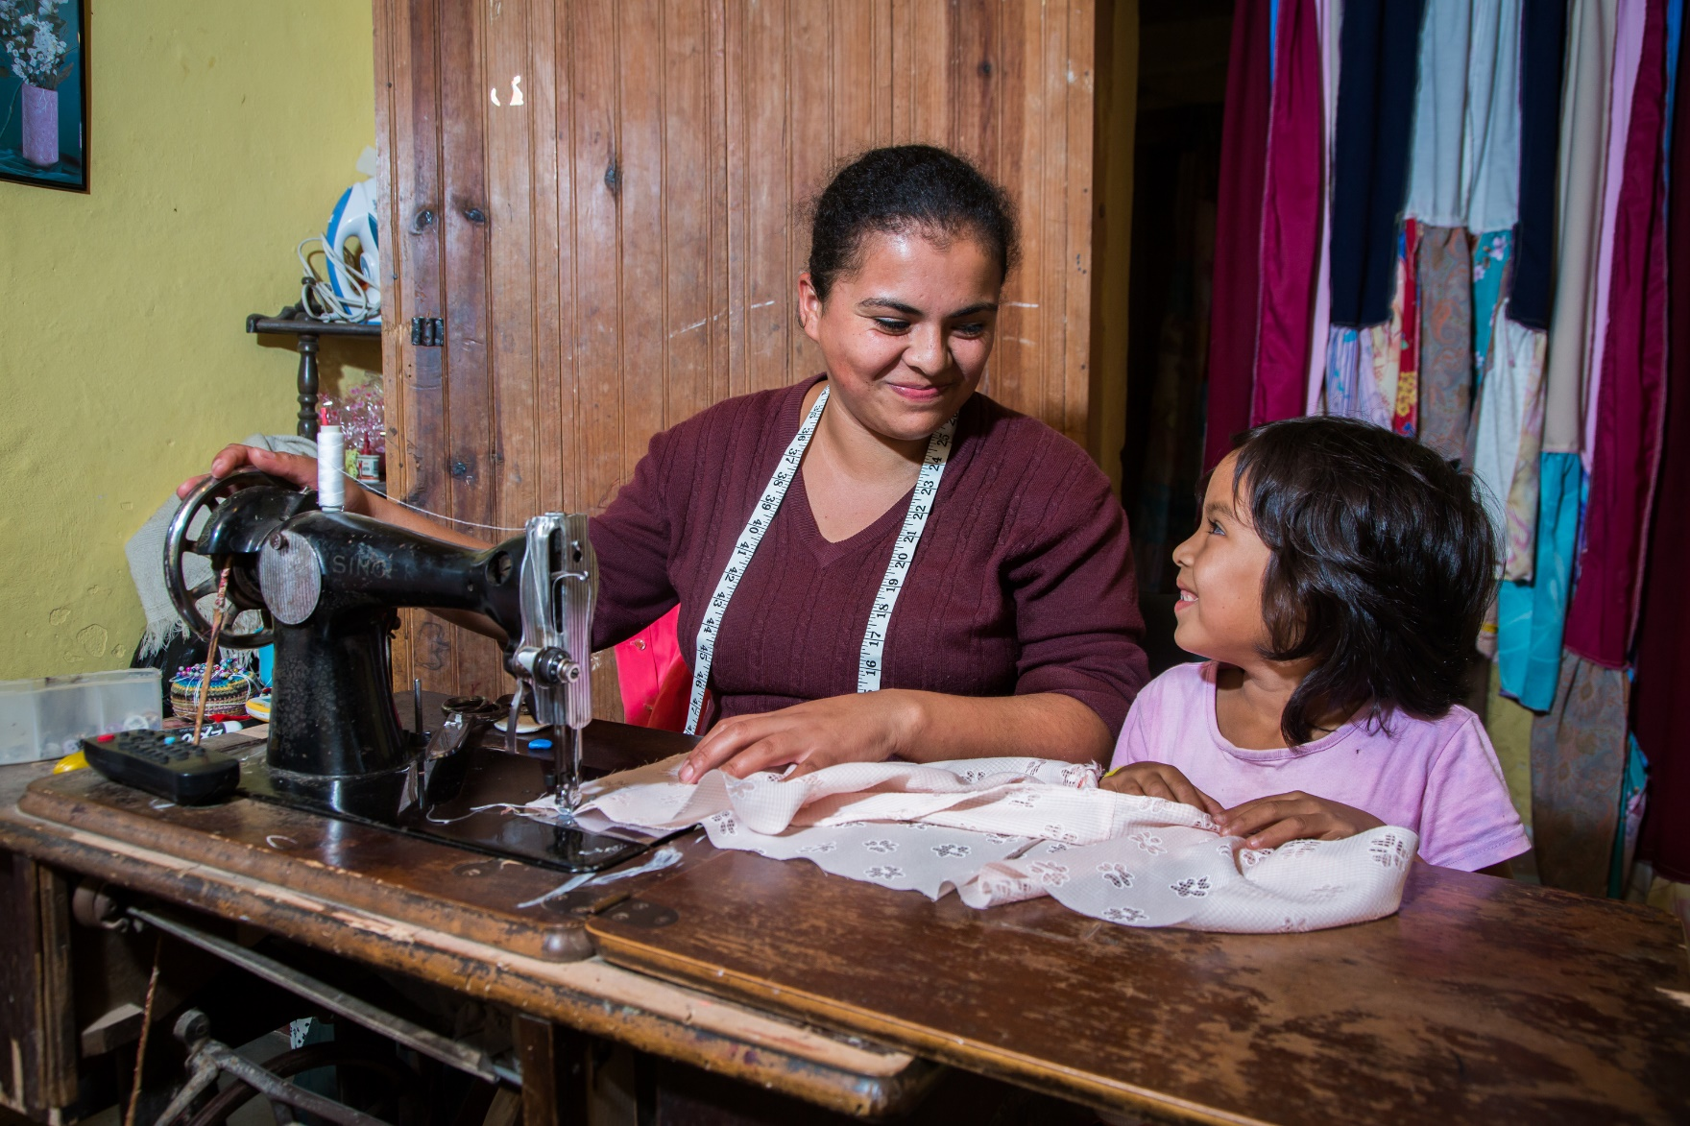
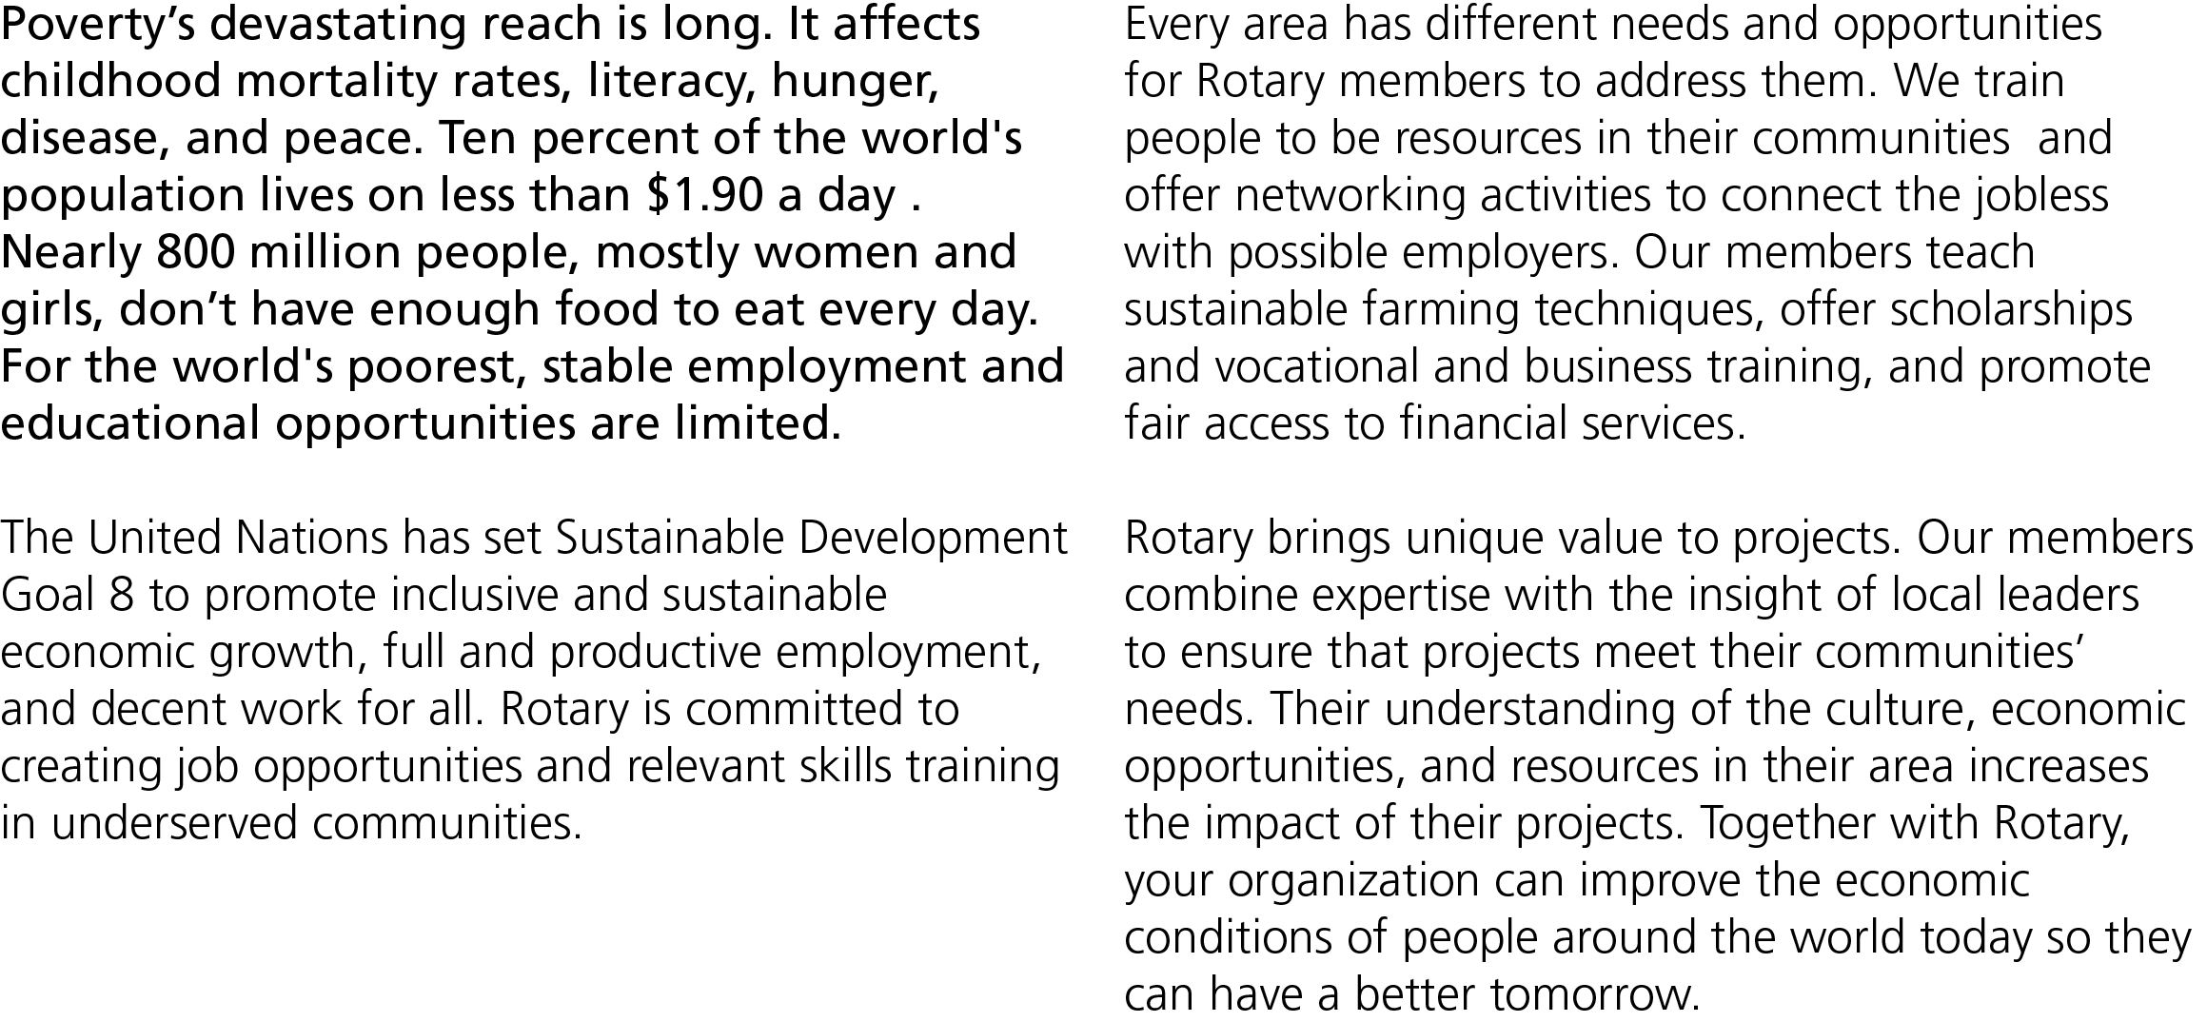

Slide 2
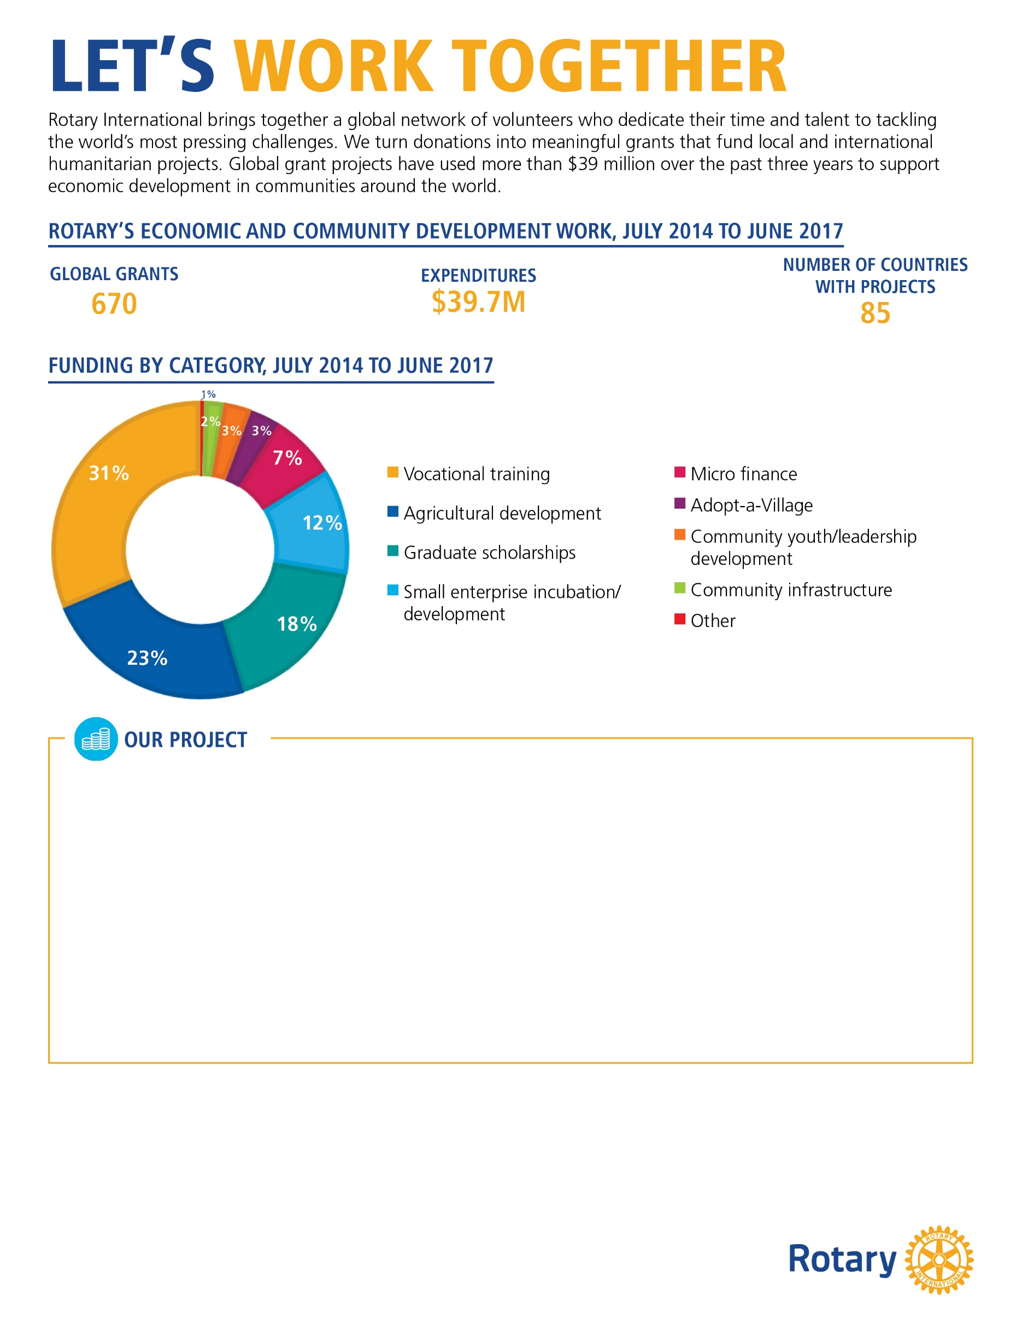
[In 500 words or less, describe an economic and community development project that your club or district either finished or is currently working on. Please use 12-point Georgia font. It’s also a good idea to include photographs of your project.]
[Your description should include:
The problem your project addresses and how it was discovered
A brief description of your community and how the project benefits it
How the partner organization’s involvement improves the project and its outcome
If the project is complete, its impact on the community (example: provided 200 microloans)
How this project will continue when Rotary’s involvement is over]
[Customizable call to action:]
Help Rotary strengthen local communities!
Your organization can have a significant impact on the lives of people in our community. Join us in providing training, microloans, economic infrastructure, and more. With your support, we can expand our local economy and give those who are most vulnerable a more prosperous future. Contact us at [insert email] or [insert phone number] to learn how you can get involved.

